Slide 1

Real Estate Valuation Dataset Project
An Analysis of Property Prices and Factors Affecting Them
A Data-Driven Approach to Understanding Property Value
NAMES: ITEKA Laure Gabriella ID:22718

Slide 2


Project Overview
This project delves into a comprehensive real estate dataset from Taiwan, aiming to unravel the intricate relationship between various property attributes and their market value.
Our primary objective is to develop a nuanced understanding of factors influencing property prices per unit area. We leveraged Python for data manipulation, Pandas for robust analysis, and Power BI for compelling visualizations.

Slide 3
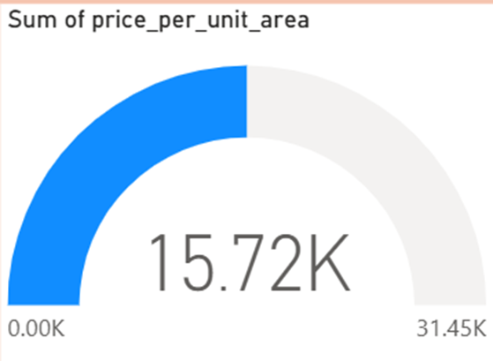
Dataset Description
Our dataset comprises 414 records, providing a rich foundation for our analysis. Each record details distinct property characteristics.
The target variable for this analysis is the price per unit area, measured in New Taiwan Dollars (NTD) per square meter. This metric allows for standardized comparison across diverse properties.
Key features include:
House age
Distance to MRT station
Number of convenience stores within proximity
Geographic coordinates (latitude and longitude)

Slide 4





Key Features & Their Impact
House Age (years)
Distance to MRT (meters)
Reflects property modernity and potential wear. Newer homes often command higher prices due to less maintenance and contemporary design.
A critical determinant of accessibility. Proximity to public transport significantly enhances property value and desirability.
Convenience Stores
Price per Unit Area
Indicates the level of local amenities and daily convenience. A higher count suggests a more vibrant and livable neighborhood.
The primary dependent variable, representing the market value normalized by area, allowing for direct comparison across different property sizes.

Slide 5




Feature Engineering for Deeper Insights
To enhance our analytical capabilities, we engineered new categorical features from existing numerical ones, enabling more granular analysis and clearer trend identification.
Age Category
Distance Category
Derived from 'house_age', grouping properties into 'New', 'Mid-age', and 'Old' to analyze age-related price differentials.
Segmented 'distance_to_MRT' into 'Close', 'Medium', and 'Far' to assess the impact of proximity to public transit.
Store Category
Price Category
Categorized 'convenience_stores' into 'Few', 'Moderate', and 'Many' to understand the influence of local amenities on price.
Created 'price_category' (e.g., 'Low', 'Medium', 'High') to segment property values and identify pricing tiers within the market.

Slide 6
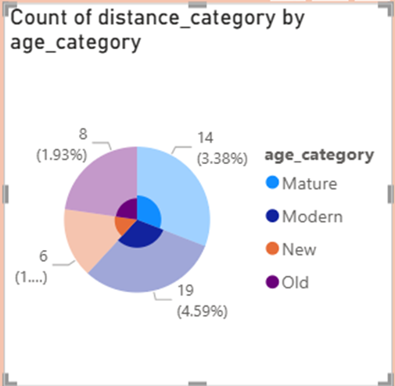
Introducing the Accessibility Score
We developed a composite Accessibility Score to quantify a property's overall convenience and connectivity. This metric integrates two vital factors:
Proximity to MRT stations: A key indicator of urban connectivity.
Availability of convenience stores: Reflecting daily utility and neighborhood vibrancy.
A higher Accessibility Score directly correlates with enhanced property desirability and, consequently, a higher price per unit area.

Slide 7

Initial Observations from Data Exploration
Our preliminary analysis yielded several clear trends:
Accessibility Premium: Properties situated closer to MRT stations and those surrounded by more convenience stores consistently exhibit higher prices.
Age Value: Newer constructions and recently built houses command a premium, reflecting modern amenities and reduced maintenance needs.
Geographic Variation: Distinct location clusters reveal significant price variations, underscoring the importance of specific neighborhoods and their unique attributes.

Slide 8
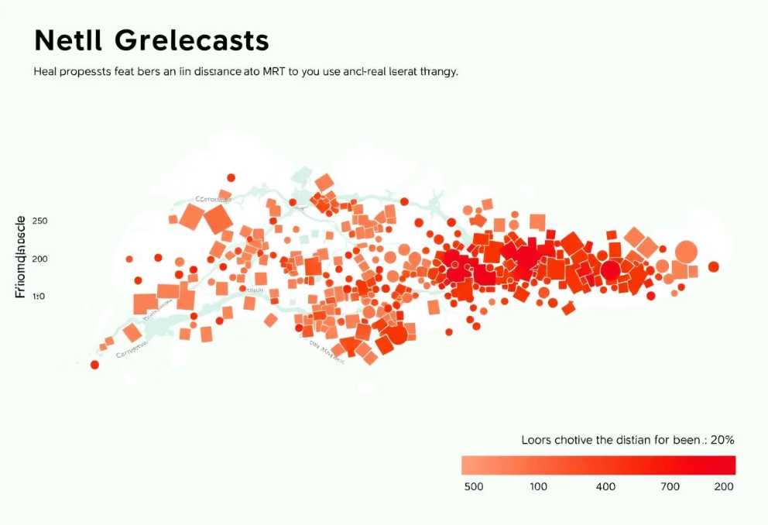
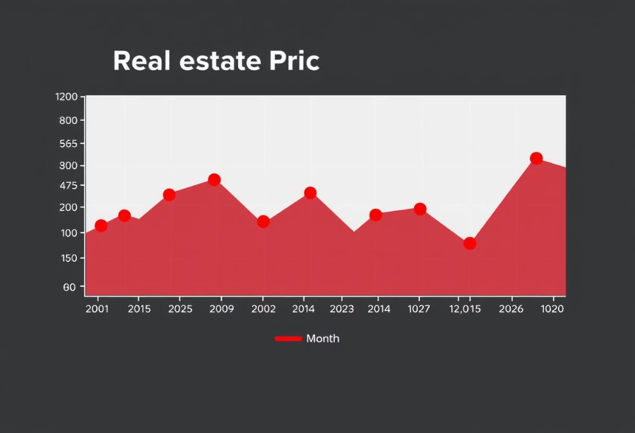
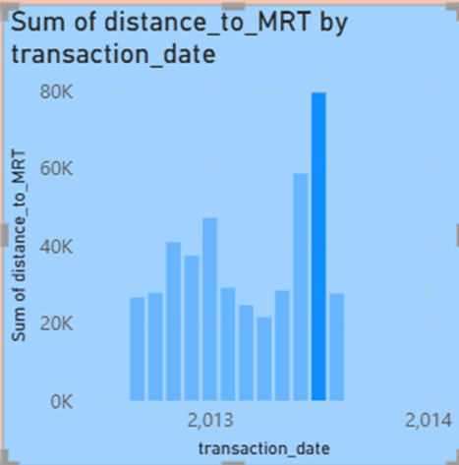
Visual Insights from Data Visualization
Power BI visualizations provided compelling evidence for the trends observed, making complex relationships easily digestible.
Correlation Heatmaps
Bar Charts on Amenities
Price Trend Lines
Visually confirm a strong negative correlation between distance to MRT and property price, with closer proximity indicating higher value.
Illustrate a clear upward trend in property value as the number of nearby convenience stores increases, highlighting the impact of local amenities.
Reveal how property prices fluctuate across different transaction years and months, indicating seasonal or market-driven variations.

Slide 9



Key Takeaways
Location is Paramount: Proximity to MRT stations and the abundance of amenities (convenience stores) are the most crucial influencers of property prices in the dataset.
Value of Modernity: Newer homes consistently demonstrate higher market value, suggesting a premium placed on contemporary construction and reduced need for renovation.
Analytical Power of Segmentation: Applying categorical segmentation and clustering techniques proved instrumental in uncovering nuanced trends and identifying distinct market behaviors across different property segments.

Slide 10

Future Enhancements & Next Steps
To further enrich this analysis and build a more predictive model, we propose the following enhancements:
Expanded Data Integration
1
Incorporate additional variables such as zoning regulations, school district ratings, demographic data, and broader economic indicators (e.g., interest rates, GDP growth) to capture a more holistic view of market dynamics.
Advanced Predictive Modeling
2
Implement sophisticated Machine Learning models (e.g., Random Forests, Gradient Boosting, Neural Networks) to develop a robust property value prediction engine, moving beyond descriptive analysis.
Interactive Dashboard Deployment
3
Develop and deploy dynamic, interactive dashboards using tools like Power BI or custom web applications. This will allow users to explore insights, run scenarios, and visualize predictions in real-time.

